Slide 1
CS 685 Spring 2017 Internet Of Things – Car’s Ecosystem Milestone 5 Car Fleet Management System Team 2 Anthony Picaro – arp223@njit.edu Nainika Aleti – na368@njit.edu Vivek Bharathwaj Ravikumar – vr329@njit.edu

Slide 2
1. INTRODUCTION 1.1 What is Fleet Management?
Fleet management is the management of a commercial transportation fleet, whether they be taxicabs, limousines, tractor-trailers, or even a local pizzeria monitoring delivery drivers.
In order to more effectively monitor and manage the fleet, software using the Internet of Things approach is employed.
FLEET MANAGEMENT

Slide 3
1.2 How Fleet Management fits into IoT Stack?
By utilizing GPS trackers and the on-board diagnostics port in each vehicle, the vehicles are connected to a central server
Some of the information is stored on local databases for a user to view later on a computer or smart device
Other information is processed in real-time to proactively monitor a vehicle
The vehicles, computers, smart devices, and GPS trackers are the most noticeable ‘Things’ in this IoT ecosystem,
The vehicle’s on-board diagnostic port will have a proprietary dongle inserted into it that will parse the information from the diagnostic port

Slide 4
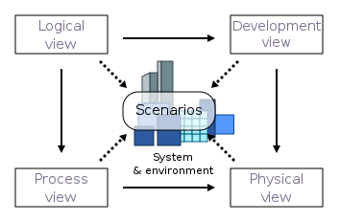
1.3. 4+1 VIEW’S OF FLEET MANAGEMENT SYSTEM
LOGICAL VIEW
PROCESS VIEW
DEVELOPMENT VIEW
PHYSICAL VIEW
SCENARIO VIEW

Slide 5
2.1 LOGICAL VIEW ARCHITECTURE
2. LOGICAL VIEW

Slide 6
2.2. LOGICAL VIEW – ARCHITECTURALLY SIGNIFICANT REQUIREMENTS
Real Time vehicle Telematics Tracking
Vehicle Scheduling and Location Tracking Solution
Fuel Tracking and Speed Control
Vehicle Usage Analysis
Car Ownership and Leasing Solution
Fleet and Driver Management
Traffic and Workload Management
Payment Gateway
Cellular Communication

Slide 7
2.3 VIEW ALIGNMENT WITH REFERENCE ARCHITECTURE – LOGICAL VIEW

Slide 8
2.3 VIEW ALIGNMENT WITH REFERENCE ARCHITECTURE – LOGICAL VIEW
CONTD.
Our Application sits in the top layer(i.e., application layer) of the IoT reference architecture and uses the services provided by the layers below it.
Our application uses the services provided by the communication layer enabling drivers to keep managers, customers updated with important information like arrival times or delays.
Uses the services offered by events layer for vehicle scheduling and location tracking to coordinate drivers, managers and customers.
Vehicle Telematics Tracking system access the data layer to store the captured GPS fleet tracking data.
It also uses the services provided by the routing layer packet routing.

Slide 9
3.1 PROCESS VIEW ARCHITECTURE
3. PROCESS VIEW

Slide 10
3.2. PHYSICAL VIEW – ARCHITECTURE EXPLANATION
It is of great importance to consider the quality attributes
It has potential impact on other requirements.
These quality attributes are identified via tradeoff analysis between multiple attributes
The priority and benefit of an attribute differs from the other.
The following are the list of quality attributes that are identified for the Fleet management application.
1. Security 6. Testability
2. Usability 7. Interoperability
3. Availability 8. Maintainability
4. Performance 9. Backup and Restore
5. Scalability 10. Resilience

Slide 11
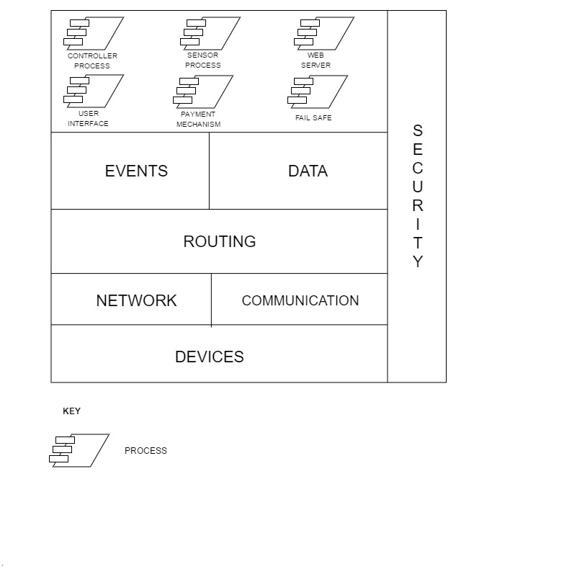
3.3 VIEW ALIGNMENT WITH REFERENCE ARCHITECTURE – PROCESS VIEW

Slide 12
3.3 VIEW ALIGNMENT WITH REFERENCE ARCHITECTURE – PROCESS VIEW
CONTD.
Our Application sits in the top layer(i.e., application layer) of the IoT Reference Architecture and uses the services provided by the layers below it.
The payment mechanism process uses the services provided by the security layer for secure online payment.
The device layer of the IoT architecture has sensor monitoring device connected to the signal and the sensor process in the process layer - enables fleet managers to monitor vehicle performance, driver behavior and other parameters.
Fail safe process uses the services provided by the data layer and comes into operation in case of a disaster triggering the backup database.
web server access the data and network layer services to serve the files that form web pages to users in response to their queries.
User interface allows user interaction with our application by accessing the data layer using the open database connectivity Interface since this layer provides the log about other layers.

Slide 13
4.1 DEVELOPMENT VIEW ARCHITECTURE
4. DEVELOPMENT VIEW

Slide 14
4.2 LAYERS IN DEVELOPMENT VIEW
The Development View Diagram has 4 layers. They are
PRESENTATION/ USER INTERFACE LAYER
This is the top most and visible layer to the end user
Responsible for providing an User Interface.
Application is developed for use in cross cutting platforms
This layer may use the services of the bottom layer
BUSINESS PROCESS LAYER
This Layer contributes to the functional aspects of the application.
Brain of the application about what an application should do.
Plays a central coordinating role.
BUSINESS LOGIC LAYER
All Business related logic is implemented here
All the components in this layer strictly adheres to the business rules
If called from the presentation/UI layer, then the components are servicing a request from the user.
If called by business process layer, then the components are being used as a part of process definition.
DATABASE LAYER
The components in this layer can send and receive data from other layers.
They also have the means to store those data and access these data via a File System.
This layer uses Relational Database System

Slide 15
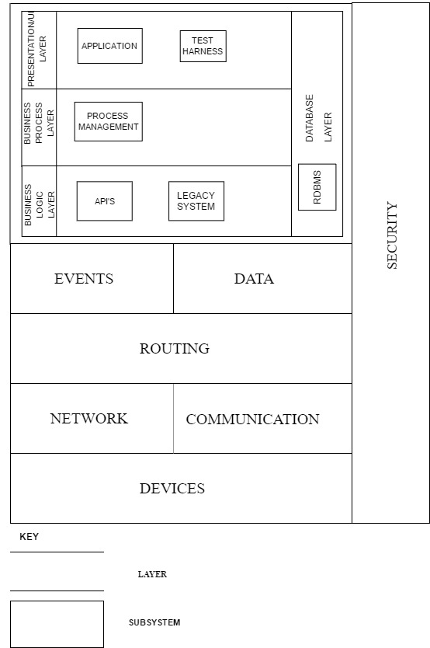
4.3 VIEW ALIGNMENT WITH REFERENCE ARCHITECTURE – DEVELOPMENT VIEW

Slide 16
4.3 VIEW ALIGNMENT WITH REFERENCE ARCHITECTURE – DEVELOPMENT VIEW. CONTD.
The Presentation/UI layer also referred to as “Fleet management software” provides user interface that is compatible with any given off-the-shelf consumer device that has a visual display and user input as required by the reference architecture.
This layer of the Development view corresponds to the bottom layer of the reference architecture, specifically the devices and OBD port dongle
The Business Process layer contains the most important part of the reference architecture: the services provided to the users. All of the functional components are included in this layer, such as the telematics tracking and vehicle location monitoring, and all of the network components are enveloped in this layer too.
Presentation/ UI layer and the Business Process layer access the services provided by the IoT using the API provided by the Business Logic Layer
The reference architecture specifically mentions “Database Control", which is what the Database layer in the Development view is. When the users of the fleet management software sign-up, they expect the information about their vehicles and routes to be recorded in real-time for future reference; the database layer’s main database exists for that purpose.

Slide 17
5.1 PHYSICAL VIEW ARCHITECTURE
5. PHYSICAL VIEW

Slide 18
5.2 NODES IN PHYSICAL VIEW
The physical view explains about the non-functional requirements of the system
Such as availability, reliability, performance and scalability of a system is achieved.
Also the executable environment of the software on a network of computers, or processing nodes
Nodes in the physical view are as follows.
APPLICATION UI
LOGIN
GPS
SENSOR
FIREWALL
ROUTER/ LOAD BALANCER
PRODUCTION AND BACKUP SERVER
TEST SERVER
APPLICATION AND BACKUP SERVER
IOT SERVER.
DATABASE/ BACKUP HOST OR SERVER
MAINFRAME SYSTEM

Slide 19
5.3 VIEW ALIGNMENT WITH REFERENCE ARCHITECTURE – PHYSICAL VIEW

Slide 20
5.3 VIEW ALIGNMENT WITH REFERENCE ARCHITECTURE – PHYSICAL VIEW. CONTD.
Our Physical View fits into the application layer of the reference architecture and uses the services provided by the layers below it.
Application Server uses various network protocols to provide middleware services for security along with data access and persistence.
The production server sends client query directly to the database server and waits for a response. Once received, the web server formulates the response into an HTML file and sends it to your web browser.
Devices and Sensor securely access the applications database. They use the IoT Services of Devices and Events that are below them.
The router transmits the packets physically across the computer Networks using the Routing and Network layer in the reference architecture and the Load Balancer manages the traffic in the network.
The Firewall node access the Security Layer provided by the IoT Reference Architecture to provide security to the application’s architecture.

Slide 21
6. SCENARIO VIEW

Slide 22
7. IoT REFERENCE ARCHITECTURE REQUIREMENTS
There must be security protocols instated that protect every layer to prevent the Fleet Management software being compromised.
The hardware layer will never interact directly with any other layers except the layer immediately above it.
The Events and Data are done on the same hardware, so they communicate directly with one another.
SERVICES | INPUT | OUTPUT | FUNCTIONALITY | ASSOCIATED ASR
Onboard Sensor Management | Events, Coordinates, Speed and Fuel Usage | Storing of these Events and data in remote location | Accessing data in remote location for Managerial purpose | Connected Vehicle Sensor
Device Management | All of the fleets device asset | Store and manage the fleets device
Car Events | Current Location, Travelling Speed, Vehicle Diagnostics | Updates the location, updates the distance travelled , speed and issues with vehicle | Calculates the estimated time to destination by periodically updating location and speed. Finds out any issues with vehicle | Vehicle Scheduling and Location Tracking Solution
Event Management | 1.Odometer Speed 2.Fuel Level and Distance Travelled | 1. Speed Monitor and Control 2. Fuel Usage tracker | Keep track on fleet vehicles’ fuel consumption and control speed by setting a threshold that gives an alert if the driver exceeds said threshold. | Fuel Tracking and Speed Control

Slide 23
Car Monitoring | Gather performance data about the car and its usage | Store and Analyze the data for future use. | It provides information about the total vehicle’s in the fleet, license plate number, distance compiled, hours completed, trips made, average and total operating cost, and percentage of utilization. | Vehicle Usage Analysis
Car Registration | Gather Driver’s Info from DMV using legacy system | Fleet Registration with self-car or car is leased | It keeps track of drivers who register with the fleet. This service keeps track of the payments due by the lessee each month and records the payment history. | Car Ownership and Leasing Solutions
Security Management | Security to all the layers of application like firewall, anti-virus, encryption | 1. Safety and security of the Application | Capability to handle any outside threats that endangers the functionality of the application | Security
Analytics | Data from all the services | Store and Analyze the data for performance, improvements | Provide Insights into vehicle and equipment usage, driver behavior, fleet productivity, areas where cost efficiency could be applied | Data Analytics
Communication –System - Mobile | Any Mobile or Communication device | Mobile Communication within fleet and passengers and drivers. | Communication in case of emergency, a driver can call a passenger to clarify about the location and vice versa | Mobile Communication

Slide 24
8. REVISION DISCUSSION
8.1 REVISED LOGICAL VIEW
Removed the Database as a Class Category
Rationale : Since it is an independent/external service and does not come under Logical View as a class category.
2. Removed the Class Category – Connected Vehicle Sensors
Rationale : Since Hardware should not be displayed in the Logical View
3. Added Payment Gateway
Rationale : As the customers must have a method to pay for the service.
4. Changes To View Alignment with reference architecture
Rationale: Instead of fitting the entre app in the top layer, we mapped the ASR’s to each layer which was corrected now
5. Updated Platform/ Service Requirements
Rationale : Included supporting logic to the general statement as to why a particular service is necessary.
8.2 REVISED PROCESS VIEW
Removed the Layered Approach
Rationale : Since Layered approach is a development view consideration. And also made it more of a
2. Removed the Process – API’s
Rationale : Since API’s are represented using connectors instead of processes
3. Changes To View Alignment with reference architecture
Rationale: Instead of including the process in the Application layer, the quality attributes were referenced, which was corrected now

Slide 25
8.3 REVISED DEVELOPMENT VIEW
1. Added Security Layer to the architecture
Rationale : Since it is a cross cutting layer that provides security to all the other layers
2. Removed the Module – Legacy Application from the Business Logic Layer from the architecture
Rationale : As they are part of the IoT App and not the Fleet Apllication
3. Removed the Module’s – API and Session Management from the Business Logic Layer
Rationale : As they are not part of Business Logic Concern and API’s are the inter-layer boundaries and not modules.
4. Changes To View Alignment with reference architecture
Rationale: Since the Database layer span the whole stack, it prevent the above layer from accessing IoT Services. Hence Database layer was changed into a crosscutting layer.
8.4 REVISED PHYSICAL VIEW
Connection between IoT Sever and GPS service
Rationale : Since the existing IoT stack requires GPS Access
2. Removed the Device Node
Rationale : Having a separate node for device and Application caused confusion as the application is deployed into the device
3. Changes To View Alignment with reference architecture
Rationale: Displays how each node in Physical View is connected to the IoT Layers

